Slide 1


Noida Institute of Engineering and Technology, Greater Noida
Introduction to Quality Management
Unit: 1
Subject Name – Total Quality Management
Faculty Name –Dheeraj Tripathi
Assistant professor
Department-ECE
Course – B.Tech 8th sem

Slide 2
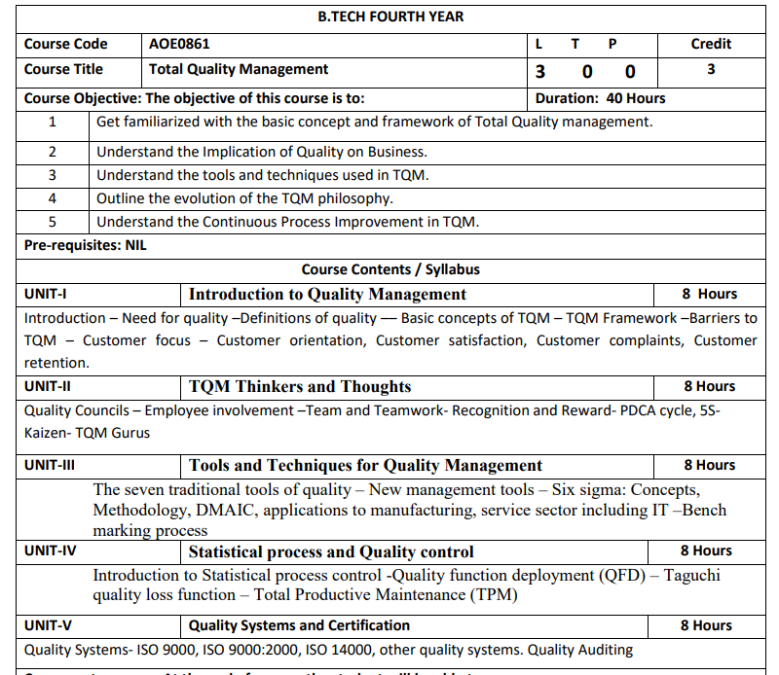
SYLLABUS

Slide 3
COURSE OBJECTIVES
AOE 0861.1 | To learn about common term Quality Concepts
AOE0861.2 | To know QM principle
AOE0861.3 | To understand the importance of different chart like P-charts and C-charts
AOE0861.4 | To know new term PDCE cycle, 5S,Kaizen
AOE0861.5 | To be aware about different ISO standards and JIT

Slide 4
COURSE OUTCOMES
AOE0861.1 | Define the Quality Concepts and Manufacturing Quality
AOE0861.2 | Conceptualize the term Quality Management and relate to this various QM Principles
AOE0861.3 | Analyze the different Tools and Techniques and Control Charts
AOE0861.4 | Distinguish between Defects Diagnosis and Prevention term
AOE0861.5 | Coordinate IS0 and its concept to Quality Management

Slide 5
PROGRAM OUTCOME
1. Engineering knowledge
2. Problem analysis
3. Design/development of solutions
4. Conduct investigations of complex problems
5. Modern tool usage
6. The engineer and society
7. Environment and sustainability
8. Ethics
9. Individual and team work
10. Communication
11. Project management and finance
12. Life-long learning

Slide 6
CO-PO MAPPING
CO | PO1 | PO2 | PO3 | PO4 | PO5 | PO6 | PO7 | PO8 | PO9 | PO10 | PO11 | PO12
AOE0861.1 | 3 | 3 | 2 | 2 | 1 | 2 | 2 | 1 | 1 | 1 | 2 | 3
AOE0861.2 | 3 | 3 | 3 | 3 | 2 | 2 | 2 | 1 | 1 | 1 | 2 | 3
AOE0861.3 | 3 | 3 | 2 | 3 | 3 | 2 | 2 | 1 | 2 | 1 | 2 | 3
AOE0861.4 | 3 | 2 | 3 | 2 | 2 | 2 | 2 | 1 | 2 | 1 | 3 | 3
AOE0861.5 | 3 | 2 | 3 | 2 | 2 | 2 | 2 | 1 | 2 | 1 | 2 | 3
Avg | 3 | 2.6 | 2.6 | 2.4 | 2 | 2 | 2 | 1 | 1.6 | 1 | 2.2 | 3

Slide 7
PROGRAM SPECIFIC OUTCOME
On successful completion of graduation degree, The computer Science & Engineering graduates will be able to:
PSO1: identify, analyze real world problems and design their ethical solutions using artificial intelligence, robotics, virtual/augmented reality, data analytics, block chain technology, and cloud computing.
PSO2: design and develop the hardware sensor devices and related interfacing software systems for solving complex engineering problems.
PSO 3: understand inter-disciplinary computing techniques and to apply them in the design of advanced computing.
PSO 4: conduct investigation of complex problem with the help of technical, managerial, leadership qualities, and modern engineering tools provided by industry sponsored laboratories.

Slide 8
CO- PSO MAPPING
CO | PSO1 | PSO2 | PSO3
AOE0861.1 | 3 | 2 | 3
AOE0861.2 | 3 | 2 | 2
AOE0861.3 | 3 | 2 | 3
AOE0861.4 | 3 | 3 | 3
AOE0861.5 | 3 | 2 | 3
Avg | 3 | 2.2 | 2.8

Slide 9
Program Educational Objectives
PEO 1: To have an excellent scientific and engineering breadth so as to comprehend, analyze, design and provide sustainable solutions for real-life problems using state-of-the-art technologies.
PEO 2: To have a successful career in industries, to pursue higher studies or to support entrepreneurial endeavors and to face the global challenges.
PEO 3: To have an effective communication skills, professional attitude, ethical values and a desire to learn specific knowledge in emerging trends, technologies for research, innovation and product development and contribution to society.
PEO 4: To have life-long learning for up-skilling and re-skilling for successful professional career as engineer, scientist, entrepreneur and bureaucrat for betterment of society.

Slide 10
SYLLABUS OF UNIT 1
Introduction
Need for quality
Definitions of quality
Basic concepts of TQM
TQM Framework
Barriers to TQM
Customer focus
Customer orientation
Customer satisfaction
Customer complaints
Customer retention.

Slide 11
QUALITY (INTRODUCTION)
Quality means “Performance upon expectations” and “fit for functions.”
A product is said to be of good quality if it satisfies the customer requirements in terms of performance, grade, durability, appearance and intended use/purpose, etc.

Slide 12
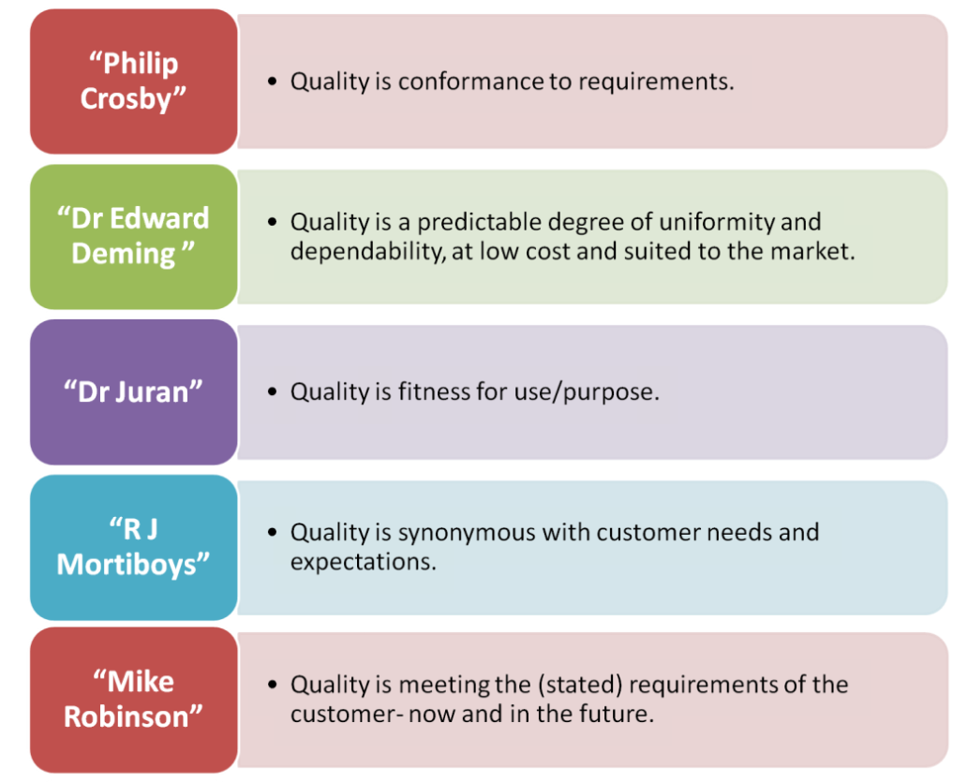
DEFINITIONS OF QUALTIY

Slide 13
NEED FOR QUALITY
Customer Expectations
Reputation
Meeting Standards
Costs

Slide 14
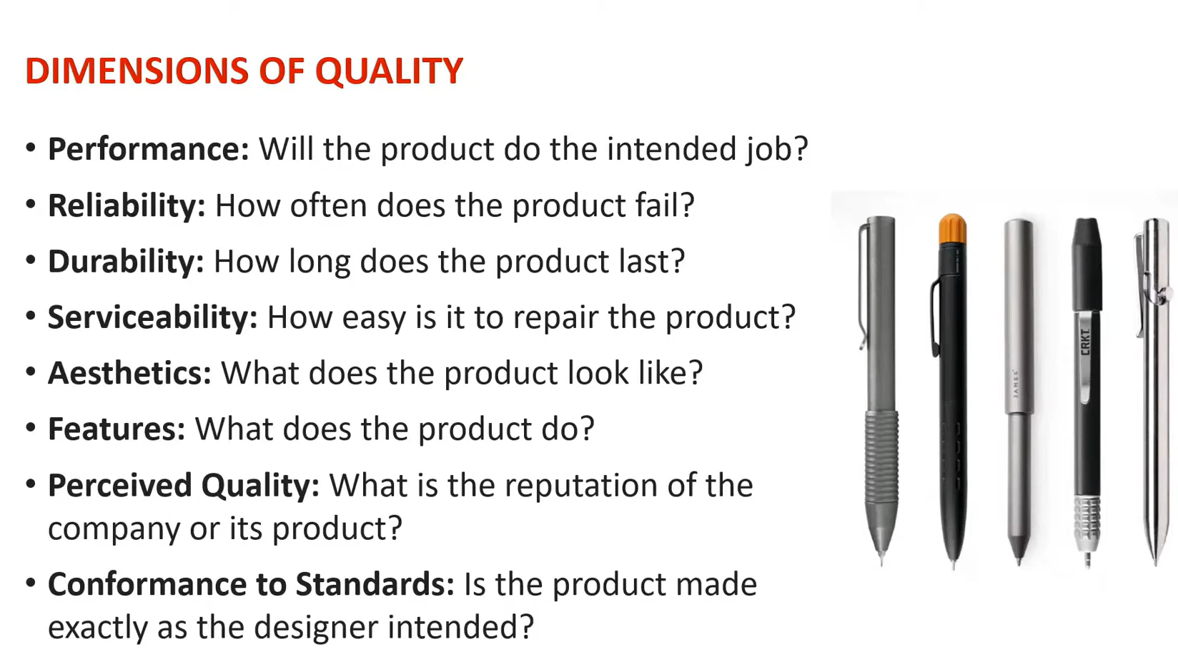

Slide 15
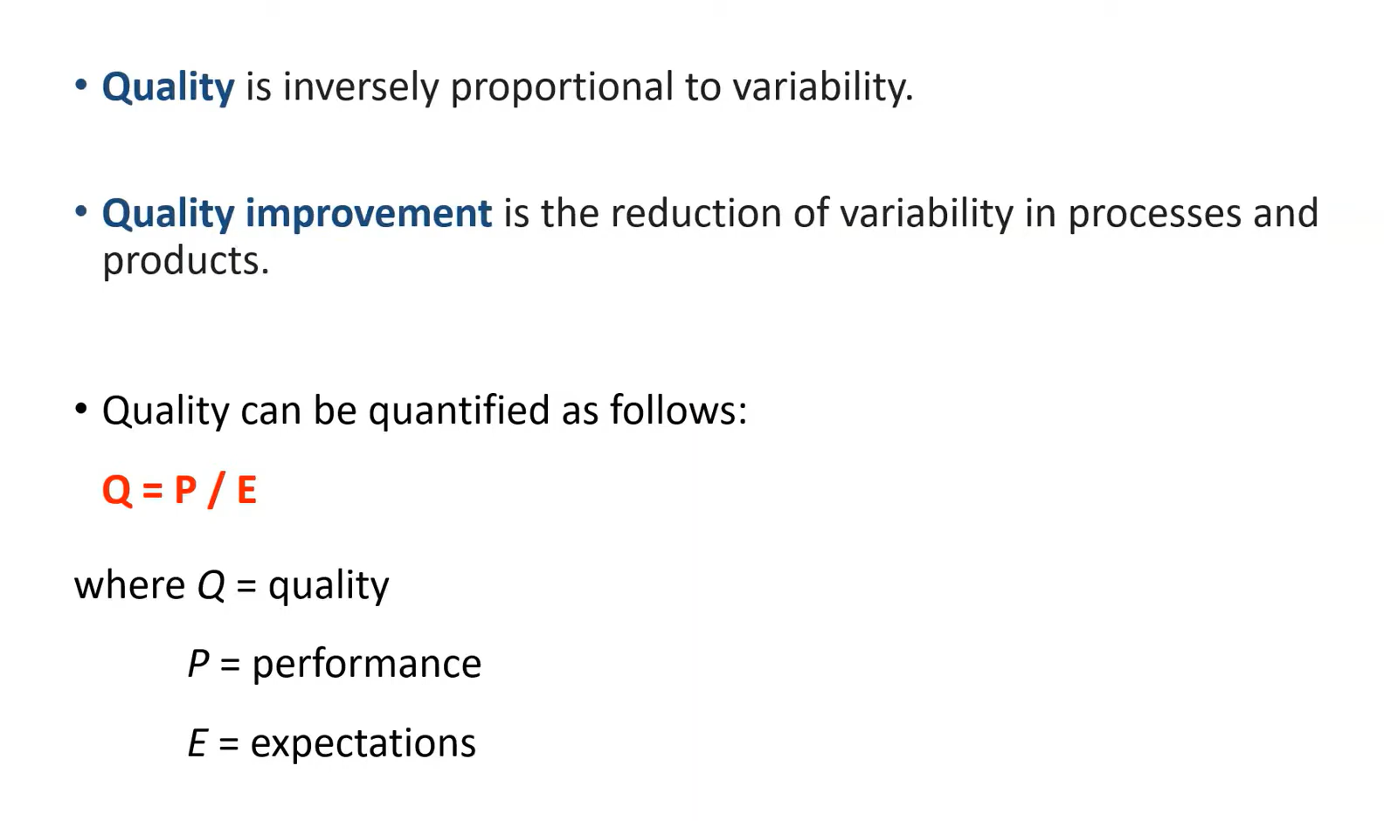

Slide 16
CUSTOMER(CO1)
In sales, commerce and economics, a customer (sometimes known as a client, buyer, or purchaser) is the recipient of a good service, product or an idea - obtained from a seller, vendor, or supplier via a financial transaction or exchange for money or some other valuable consideration
An external customer of an organization is a customer who is not directly connected to that organization.
An internal customer is a customer who is directly connected to an organization, and is usually (but not necessarily) internal to the organization.
Internal customers are usually stakeholders, employees, or shareholders

Slide 17
DAILY QUIZ
1. How will you quantify the term quality?
2. What do you understand by quality audit?
3. What is customer's expectations?
What is external customer ?
What is Internal customer?

Slide 18
BASIC CONCEPTS OF TQM
What is Total Quality Management (TQM)?
Total Quality Management (TQM) is a management framework
It is based on the belief that an organization can build long-term success by having all its members
TQM focus on improving quality and, delivering customer satisfaction.
used to simplify supply chain management
detect, reduce or remove errors.
Kaizen.

Slide 19
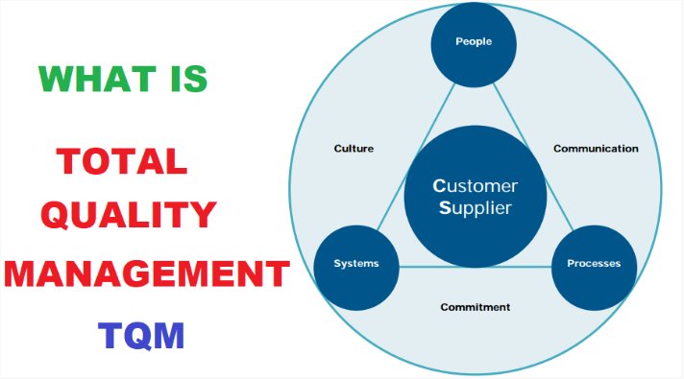
BASIC CONCEPTS OF TQM

Slide 20
BASIC CONCEPTS OF TQM
Principles of TQM
The eight guiding principles that TQM uses to improve quality include the following:
Customer focus
Employee involvement
Focus on process
Integrated business systems
Strategic and systematic approach
Continual improvement
Focus on data
Communication

Slide 21
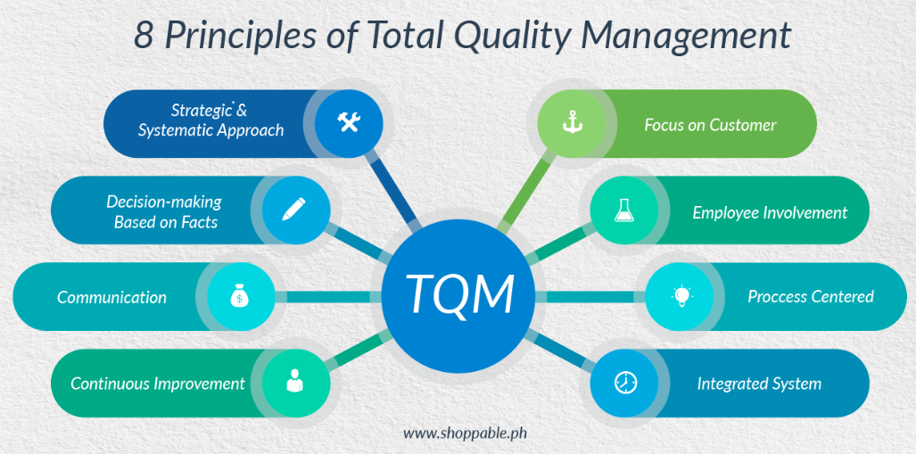
BASIC CONCEPTS OF TQM

Slide 22
BASIC CONCEPTS OF TQM
Implementation principles and processes
The general process of implementing TQM follows these steps:
The organization assesses its current culture and quality management systems and identifies core values.
Management decides to commit to TQM and develops a TQM master plan.
The organization identifies and prioritizes customer demands.
Management maps the processes needed to meet customer needs.
Management creates a team to oversee efforts to improve processes.

Slide 23
BASIC CONCEPTS OF TQM
6. Management starts contributing to the process by providing additional planning and training.
7. Management creates a process to standardize daily process management.
8.Management continually asks employees for feedback.
Implementing TQM is a long-term commitment, and the length of time needed for planning, development and implementation varies by organization.

Slide 24
BASIC CONCEPTS OF TQM
Benefits of TQM
TQM offers the following benefits:
Less product defects
Satisfied customers
Lower costs
Well-defined cultural values

Slide 25
BASIC CONCEPTS OF TQM
Disadvantages of TQM
The downsides of TQM include the following:
Planning and resources
Companywide commitment
Added costs
Time
Partial efforts

Slide 26
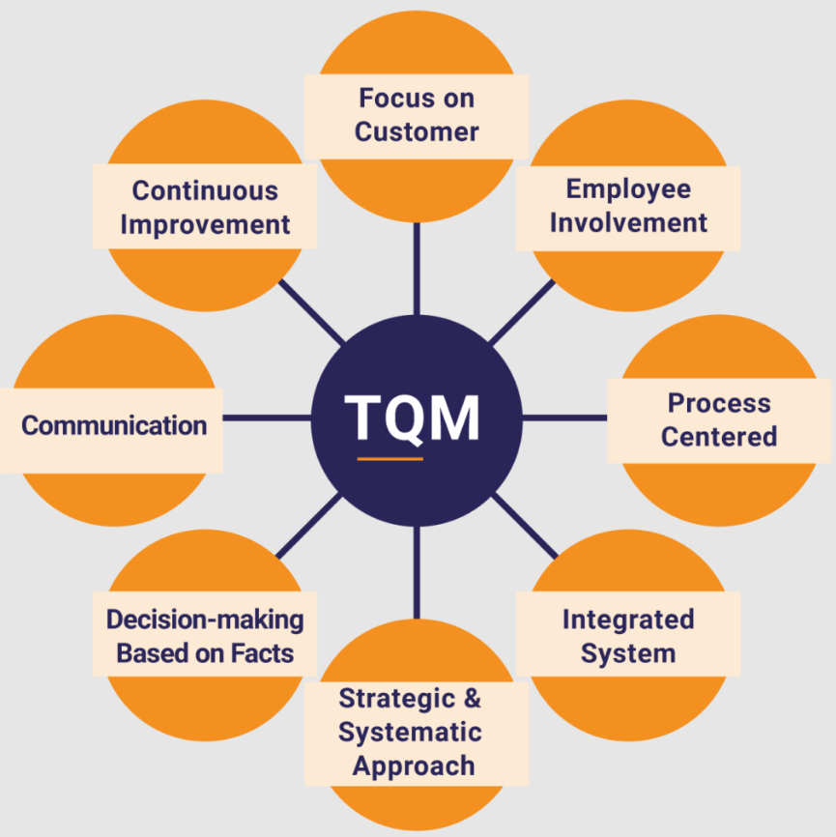
BASIC CONCEPTS OF TQM

Slide 27
BARRIERS TO TQM
Implementation of Quality
Competitive Markets
Bad attitudes of Management/infallibility
Lack of leadership for quality
Deficiency of cultural dynamism
Inadequate resources for TQM
Lack of customer focus
Lack of effective measurement of quality improvement
Poor Planning
Lack of Management commitment
Resistance to the work force
Lack of proper training/Inadequate human resource development

Slide 28
CUSTOMER FOCUS
Having a customer focus ensures that your customer receives the benefit of a product or service you are offering.
If your product fulfills a need and lasts as long or longer than expected, customers know that they have spent their money on a quality product.
To implement this:
Research and understand your customers’ needs and expectations.
Align your organization’s objectives with customer needs.
Communicate with customers, measure satisfaction, and use the results to find ways to improve processes.
Manage customer relationships.
Find a balance for satisfying customers and other interested parties (such as owners, employees, suppliers, and investors).

Slide 29
CUSTOMER ORIENTATION
Customer orientation is a business approach that puts the needs of the customer over the needs of the business.
Customer-oriented companies understand that the business won't thrive unless it consistently improves customer focus. Building a customer-oriented culture means recognizing that customers are the business.
Customer orientation is a business approach in which a company solves for the customer first. For customer service, this means your support team is focused on meeting customer needs.

Slide 30
How To Implement Customer Orientation
1. Recruit the right people.
2. Value your employees.
3. Provide excellent training.
4. Lead by example.
5. Understand the customer.
6. Iterate your process.
7. Empower your staff.
8. Receive feedback.

Slide 31
WHAT IS CUSTOMER SATISFACTION?
Customer satisfaction is defined as a measurement that determines how happy customers are with a company’s products, services, and capabilities.
Customer satisfaction information, including surveys and ratings, can help a company determine how to best improve or changes its products and services.
Within organizations, customer satisfaction ratings can have powerful effects.
They focus employees on the importance of fulfilling customers’ expectations.
When these ratings dip, they warn of problems that can affect sales and profitability.
When a brand has loyal customers, it gains positive word-of-mouth marketing, which is both free and highly effective.

Slide 32
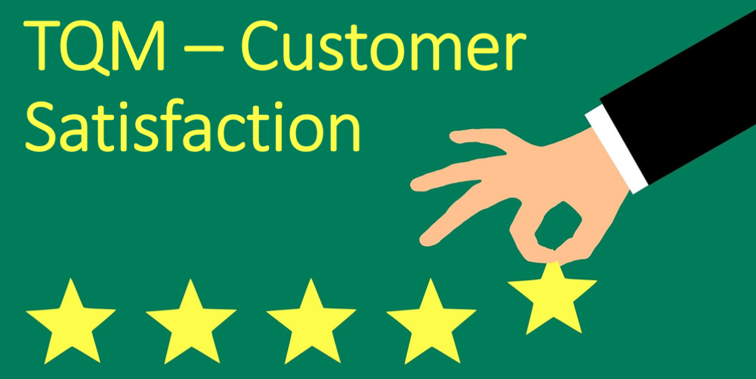

Slide 33
APPROACHES OF CUSTOMER SATISFACTION
Regular customer feedback system
Market research
New or last customer survey
Focus groups
Customer visits
Front line personnel
Critical incidents technique

Slide 34
CUSTOMER COMPLAINTS
Customer complaints are negative pieces of feedback consumers provide about a company’s product, service, or support experience.
Customers can privately submit this type of feedback by completing a survey or emailing the support team.
They can also publicly submit complaints via social media reviews, community forums, or online review sites.
Below are a few common customer complaints you can expect your service team to encounter.
Long wait times
Automated phone loops
Unsupportive agents
Inconsistent information
Inconvenient customer service hours
Lack of self-service options

Slide 35
How to handle customer complaints
Review key customer details
Check common complaints
Understand the customer
Cultivate the right tone of voice
Practice reflective listening
Acknowledge frustrations
Set realistic expectations
Present a solution
Follow up with the customer

Slide 36
CUSTOMER RETENTION
Customer retention is a metric that measures customer loyalty, or the ability for an organization to keep its customers over time.
Customer retention can reflect or predict customer satisfaction, repurchase behavior, customer engagement and emotional ties to a brand.
While customer relationships typically begin with an initial interaction, customer retention metrics are related to the first purchase made by a customer and include all subsequent interactions.
Customer retention is critical because the cost of acquiring new customers is much higher than retaining existing customers.
Retained customers are also more likely to engage in word-of-mouth marketing or become brand ambassadors.

Slide 37
Why is customer retention important for businesses?
If an organization does not focus on customer retention but instead focuses solely on expanding its customer base, it is potentially losing out on repeat customers.
While the process of gaining new customers, or customer acquisition, is important, it is also much more expensive.
Maintaining customers and transitioning them into recurring customers is just as important of a process as gaining new ones.

Slide 38
How to measure customer retention and key metrics?
Customer retention is typically measured in terms of retention rate and should be monitored continuously.
The first step to determining this rate is to identify the period of time an organization wants to record.
This can range from a month to a fiscal year or beyond.
Other factors used to determine the retention rate include the following:
the number of customers in the customer base at the start of the period (S);
the number of customers at the end (E); and
the number of new customers acquired over time (N).

Slide 39
These metrics should be recorded. Once retrieved, the formula is applied as follows:
(E-N)/S x 100 = retention rate
For example, if an organization starts with 750 customers and ends with 950, but acquires 625 over the period of time, the customer retention rate would be 43.3%.

Slide 40
Customer retention strategies
Some best practices and strategies to follow when considering customer retention strategies include the following:
Offer personalized service
Use data to provide personalized support interactions
Use social media
Incentivize loyalty
Gather customer feedback
Build trust
Improve customer support services

Slide 41
FACULTY VIDEO LINKS, YOUTUBE & NPTEL VIDEO LINKS AND ONLINE COURSES DETAILS
https://www.youtube.com/watch?v=Q3EOCAuExJU
https://www.youtube.com/watch?v=yWlAOFs04go
https://www.youtube.com/watch?v=QifqIoUNTJM
https://www.youtube.com/watch?v=qb3mvJ1gb9g
https://www.youtube.com/watch?v=2ePeXePNLrs
https://www.youtube.com/watch?v=HkdoR-NNEoI
https://www.researchgate.net/publication/318654507_Total_Quality_Management_Notes
http://www.mescenter.ru/images/abook_file/Total_Quality_Management_and_Six_Sigma.pdf

Slide 42
WEEKLY ASSIGNMENT
1. What is quality?
2. What is QM?
3. How can we achieve organizational excellence with quality?
4. What is the Deming cycle?
5. What are the most common errors when starting quality initiatives?
6. Explain the cost of poor quality.
7. What are the quality characteristics of world-class organizations?
8. Discuss some models for ethical quality decisions.
9. What is the engineering manager’s role in quality ethics?

Slide 43
MCQs
1. What is the aim of fool proof technique used for total quality management?
a. to achieve zero defects b. to specify time schedules c. to specify targets d. none of the above
2. Quality improvement planning is related to which category of cost?
a. Cost of failure
b. Cost of appraisal
c. Cost of prevention
d. All of the above

Slide 44
MCQs
3 . Match the following group 1 items (Authors) with group 2 items (Definitions) 1. Juran ------------------------------------------------- A. Quality is conformance to requirements 2. Crossby --------------------------------------------- B. Quality in essence is a way of managing the organization 3. Hoshin ----------------------------------------------- C. Quality is fitness for use
4. Feigenbaum ----------------------------------------- D. Quality is correcting and preventing loss,not living with loss
a. 1 – A, 2 – D, 3 – B, 4 – C
b. 1 – C, 2 – A, 3 – D, 4 - B
c. 1 – B, 2 – A, 3 – C, 4 - D
d. 1 – D, 2 – A, 3 – B, 4 - C

Slide 45

MCQs
4. According to Deming, Quality problems are
a. Due to management
b. Due to method
c. Due to machine
d. Due to material
5. quality planning, quality control and quality improvement are called ------------- trilogy
a. shingo
b. crosby
c. deming
d. juran

Slide 46
MCQs
6. Which of the following strategies of Deming's fourteen points is included into category of Management commitment? a. Institute leadership
b. Encouraging education
c. Eliminating exhortations
d. Adopting new philosophy
7. The concepts of quality planning, quality control, quality improvement known as ‘Trilogy of quality’ was introduced by ………………….
A. Philip B. Crosby
B. Edward Deming
C. A. Shewhart
D. Dr. Juran

Slide 47
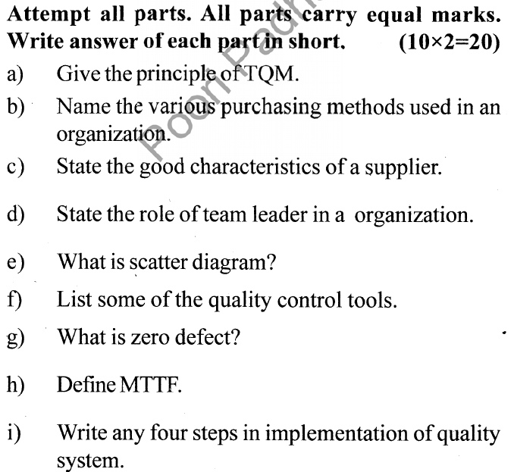
OLD QUESTION PAPERS

Slide 48
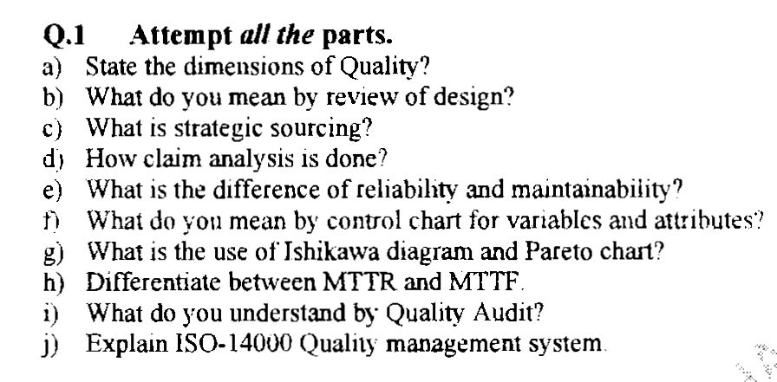
OLD QUESTION PAPERS

Slide 49
EXPECTED QUESTIONS FOR UNIVERSITY EXAM
1. How will you quantify the term quality?
2. What do you understand by quality audit?
3. Briefly explain the term QM?
4. State the good characteristics of a supplier.
5. Discuss the several dimensions of product and service quality.
6. What do you mean by warranty and guarantee? How are they being analyzed and set?

Slide 50
EXPECTED QUESTIONS FOR UNIVERSITY EXAM
7. What is the important role of senior management?
8. What are the various quality statements?
9. What is a quality policy?
10. Give the need for a feedback in an organization?
11. What are the elements of customer service?
12. State Frederick Herzberg’s Two-factor theory?
13. What does an employee want?

Slide 51
SUMMARY
Quality is customer satisfaction
Customer is the centre point for product
Need of modern approach
Deming point

Slide 52
REFERENCES
Text Book
Lt. Gen. H. Lal, “Total Quality Management”, New Age International Publishers
Greg Bounds, “Beyond Total Quality Management”, McGraw Hill
Menon, H.G, “TQM in New Product manufacturing”, McGraw Hill
Reference Book
Total Quality Management” by Besterfield
“Total Quality Management” by Mukherjee
Total Quality Management” by Vijayan
“Total Quality Management- Text and Cases” by Janakiraman B and Gopal R K
https://www.researchgate.net/publication/318654507_Total_Quality_Management_Notes

Slide 53
Thank You

